Slide 1
Vital Signal Datasets & Application : cNIBP
광운대학교 채종의
Apr / 26 / 2023

Slide 2
Contents
PPG to cNIBP
PPG , BP
BP ( IBP / NIBP / cNIBP )
rPPG -> Video to cNIBP
MIMIC Dataset
Introduction & Type
Data Structure
Instruction & Pre-processing
Expandability with inter-MIMIC datasets
Acquisition
Proposed 1D Signal Preprocessing Method and Analysis
Precautions
Analysis

Slide 3
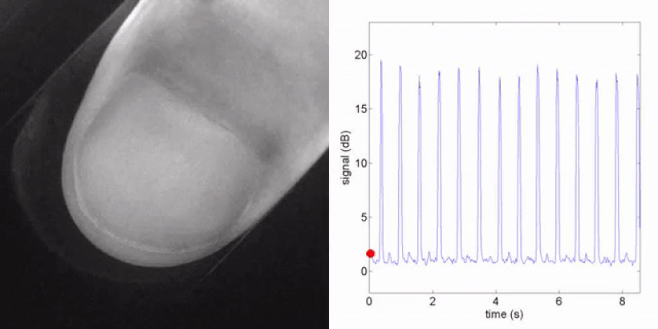
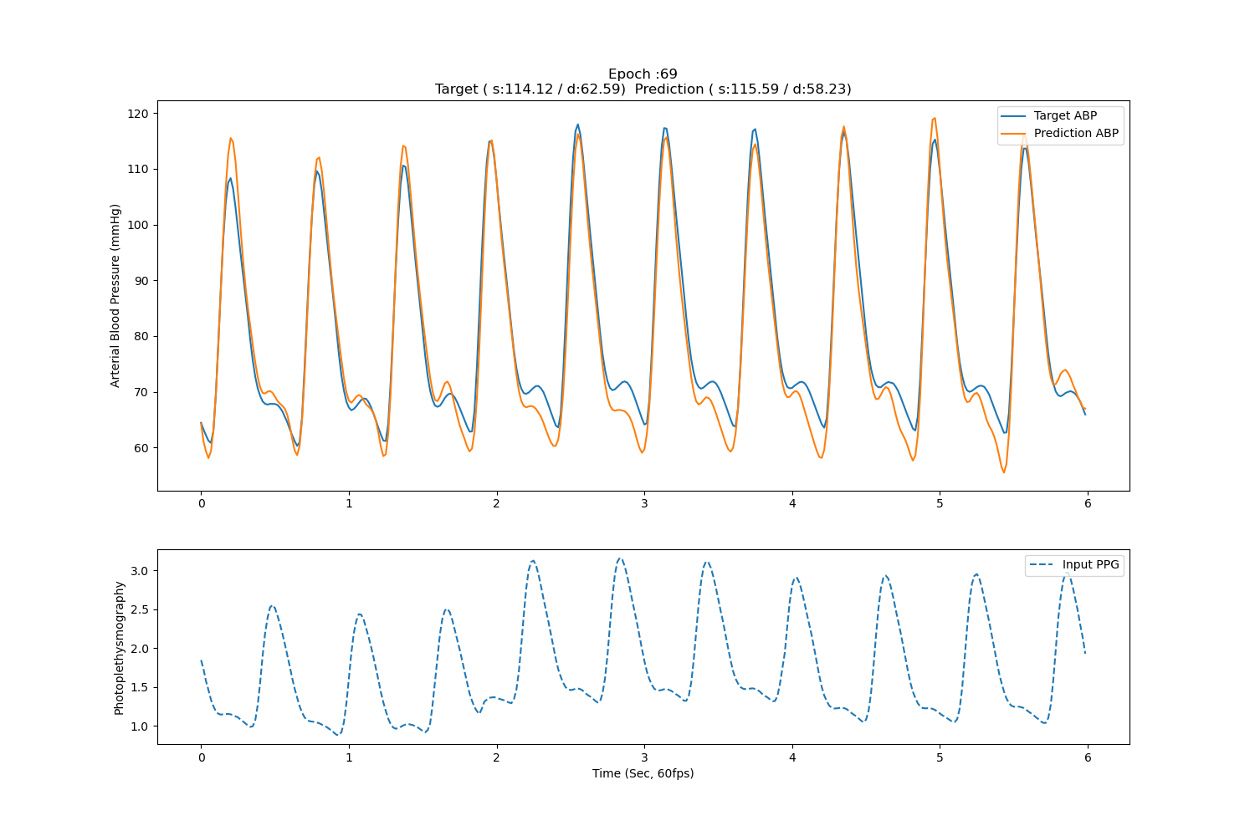
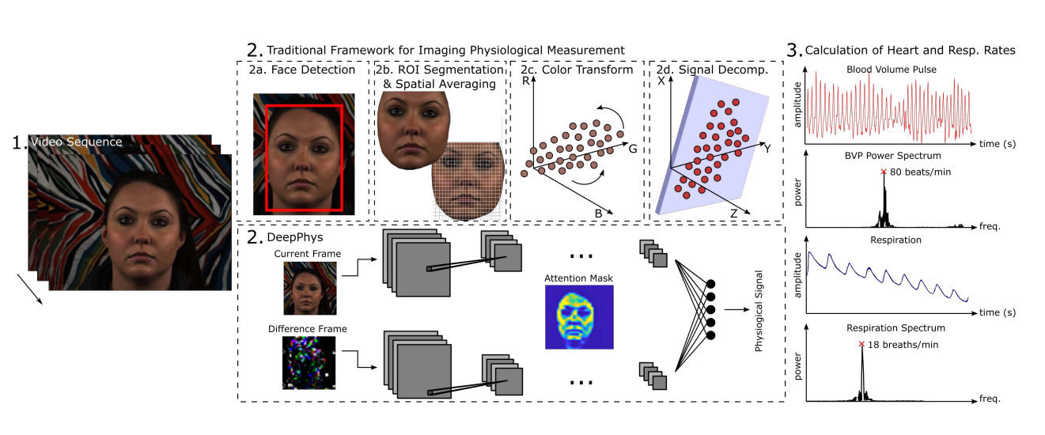
PPG to Continuous Non-Invasive Blood Pressure(cNIBP)
Photoplethysmography (PPG)
빛으로 혈액의 변화량을 기록하는 기술
Remote PPG (rPPG)
Blood Pressure (BP)
Non Invasive Blood Pressure(NIBP)
Cuff-based Blood Pressure
Continuous Non-Invasive Blood Pressure(cNIBP)
Invasive Blood Pressure(IBP)
Arterial Blood Pressure(ABP)
cNIBP example

Slide 4
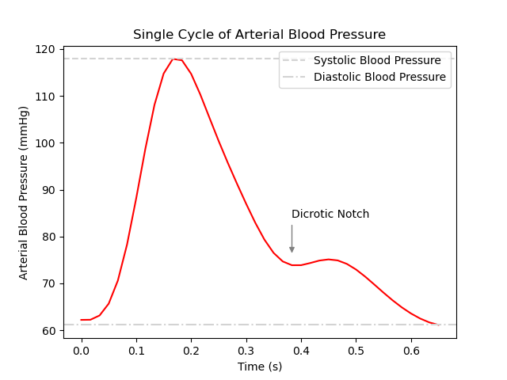
PPG to cNIBP(cont.)
Blood Pressure (BP)
Measurement Aspect | 측정 방식
 | Non-Invasive (Cuff) | Invasive (ABP)
장점 | 간단한 사용 방식 | 즉각적인 혈압의 변화량 확인 가능 파형의 형태 분석 가능
단점 | 단일 숫자 값 제한된 자세 | 개인이 사용 불가능 피부에 상처
Data Aspect | 측정 방식
 | Intermittent (DBP, SBP) | Continuous (ABP)
장점 | 다루기 편함 | 높은 활용도
단점 | 낮은 활용도 | 다루기 불편함
Continuous + Non-Invasive !!!

Slide 5
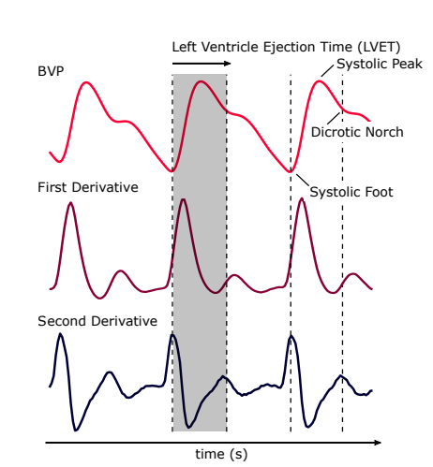
PPG to cNIBP(cont.)
Network Architecture
Vid
BP
High-order
Vid to PPG Net
High-order
PPG to BP Net
PPG loss
BP loss
BP + PPG loss

Slide 6

MIMIC Database
Stands for Medical Information Mart for Intensive Care
Large, freely-available database comprising deidentified health-related data from patients who were admitted to the critical care units of the Beth Israel Deaconess Medical Center
Waveform Database
CXR Database
MIMIC-IV waveform Database
MIMIC-III waveform Database
Chest Radiographs in DICOM format
Clinical Database
MIMIC-IV(2008-2019) / +400,000 patients
MIMIC-III Clinical Database(2001-2012) / +40,000 patients
MIMIC-II Clinical Database(2001-2008)
ED Database
Note Database
Emergency Department admissions
Deidentified free-text clinical note

Slide 7
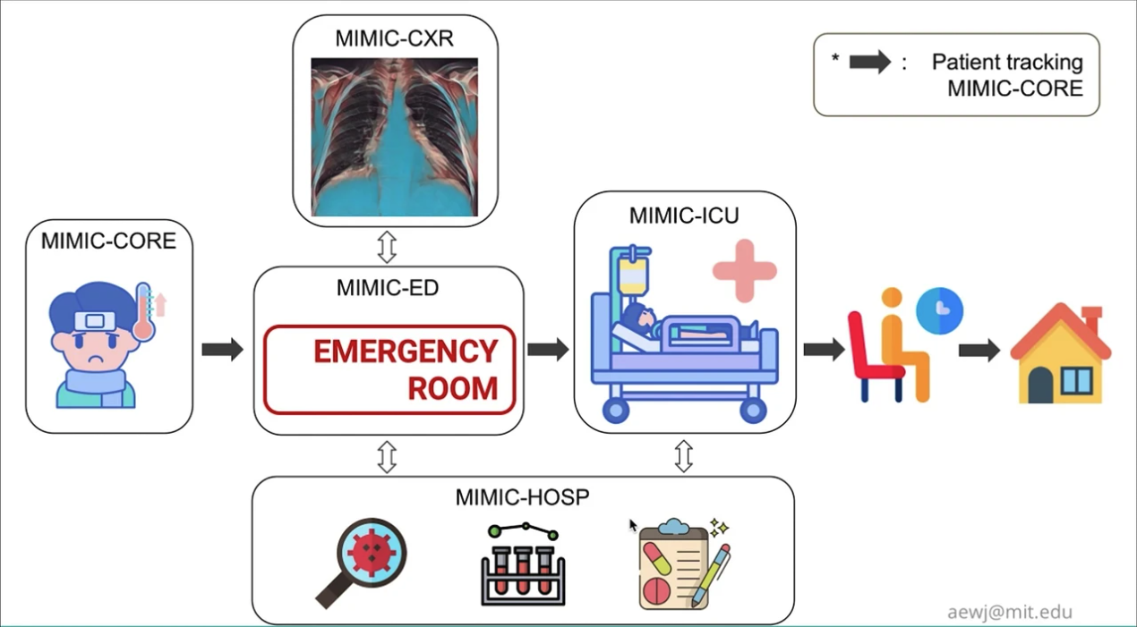
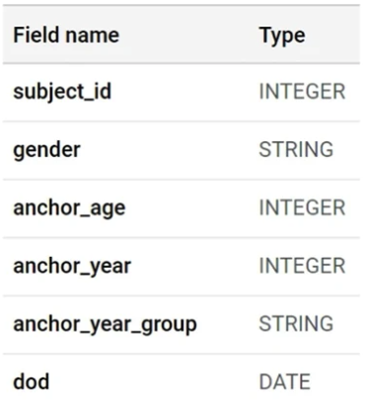
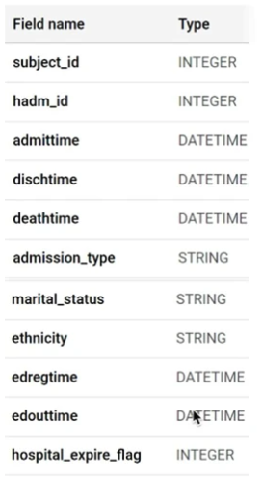
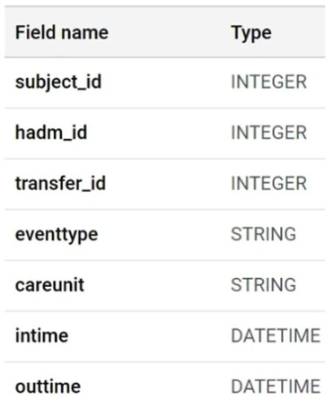
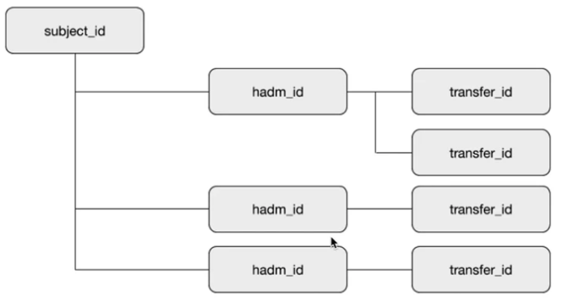
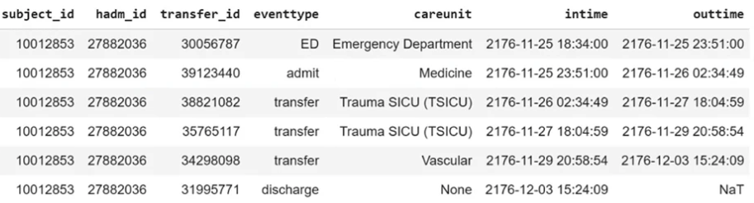
MIMIC Database(cont.)
MIMIC-CORE (Clinical Database)
patients, admissions, transfers, etc..
Information of Patients

Slide 8
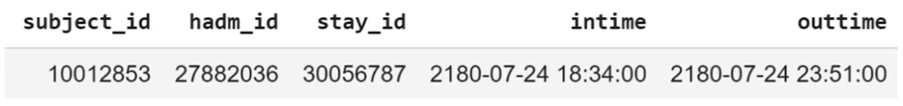
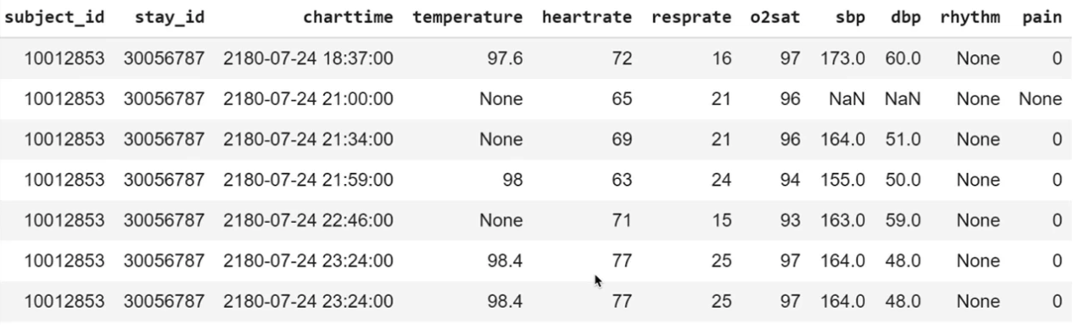
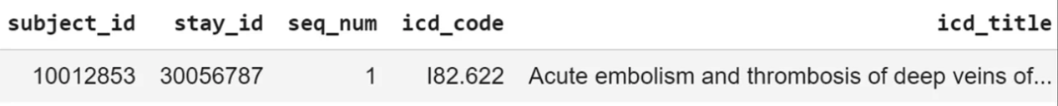
MIMIC Database(cont.)
MIMIC-ED
edstays, triage, vitalsign, medrecon, diagnosis
All tabels link to edstays on stay_id
Patient 10012853
Admitted via the emergency department to the trauma/surgical ICU
Transferred from the ED to the hospital for an acute embolism

Slide 9
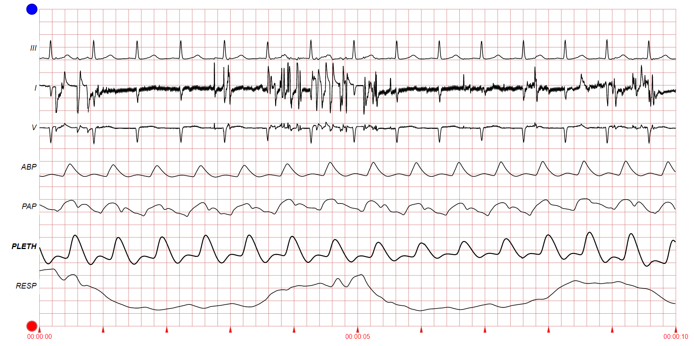
MIMIC Database(cont.)
MIMIC-Waveform Database
Including ECG, ABP, respiration, PPG and numeric records
https://physionet.org/content/mimic3wdb/1.0/
30
3000003
.hea
.dat
3099997
Segment
39

Slide 10
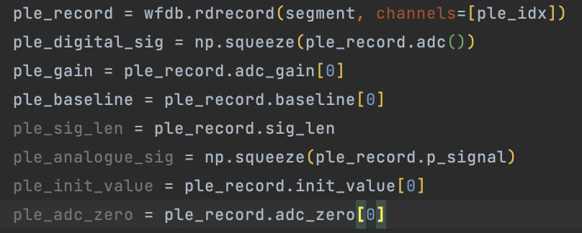
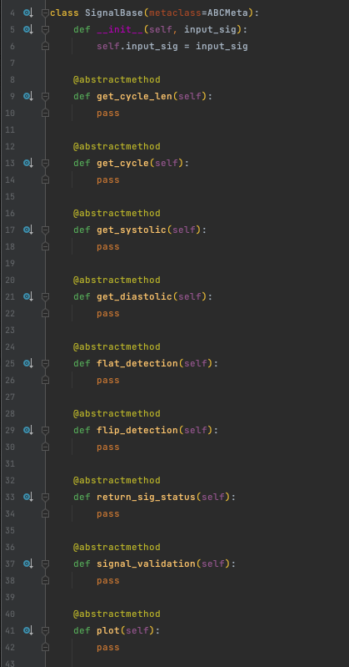
MIMIC Database(cont.)
WFDB (WaveForm-DataBase)
Python package for waveform database
https://wfdb.io/mimic_wfdb_tutorials/intro.html
PPG Segments with Various Length
PPG & ABP Chunk with Feature Points
Too short
Too long
Same length

Slide 11
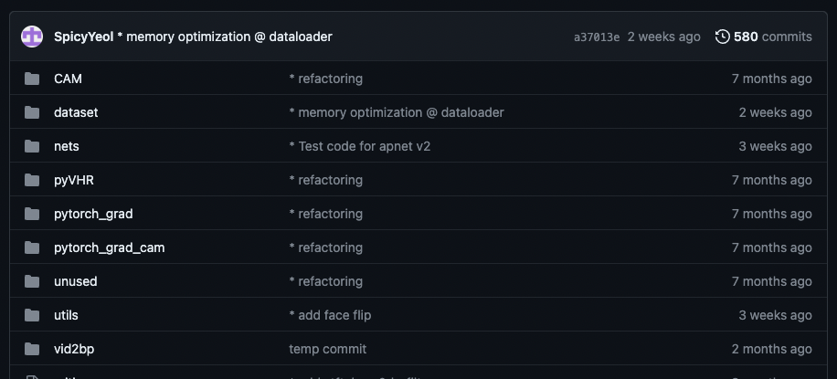
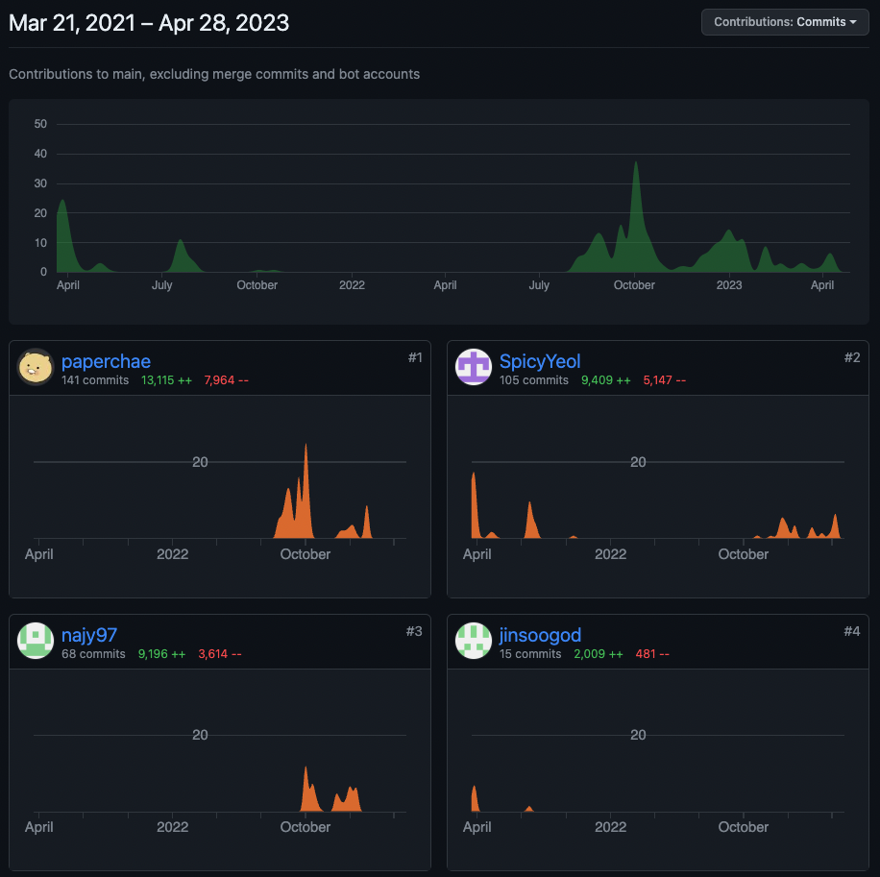
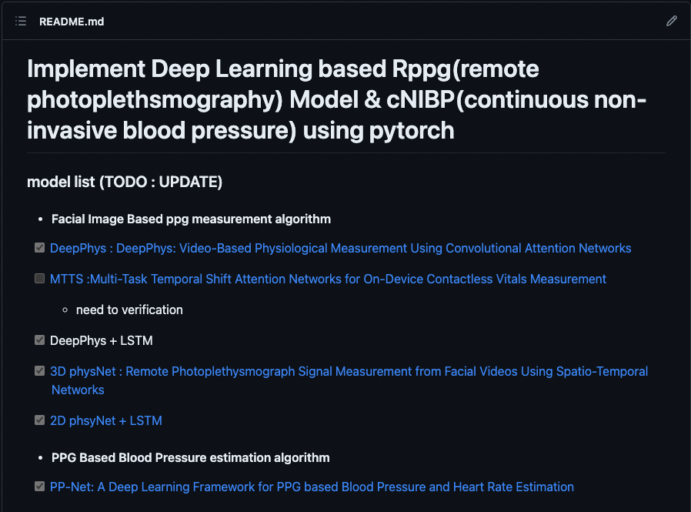
Remotebiosensing Repository
https://github.com/remotebiosensing/rppg

Slide 12
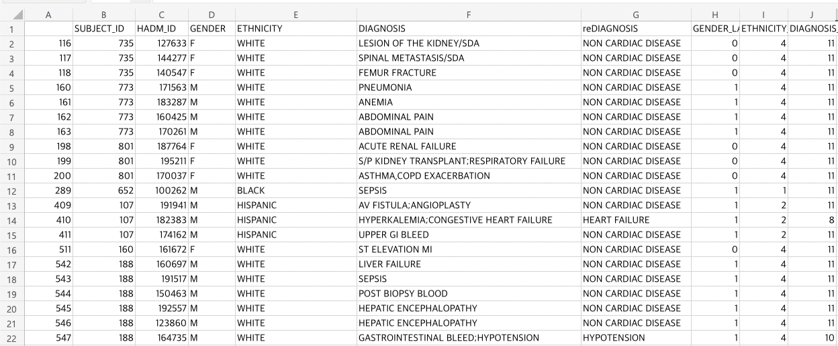
MIMIC Database(cont.)
MIMIC Clinical Database
Patients table + Admission table Dataframe

Slide 13
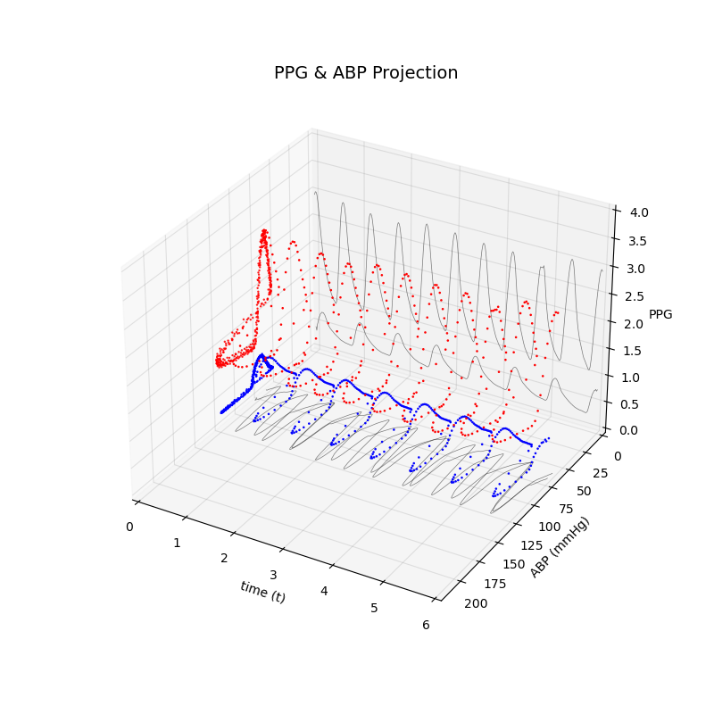
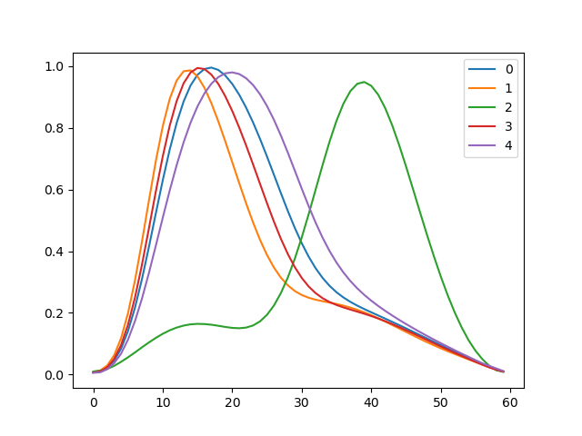
MIMIC Database(cont.)
Precautions during Pre-processing MIMIC Dataset
Tons of Problems with raw Signals!!! - Problems with Signal Itself ( 1 )
Problems for both PPG & ABP Signals
Flat
LR Flip
Problem for PPG Signals
Scale Problem
Problem for ABP Signals
Damp Problem
Similar amplitude

Slide 14
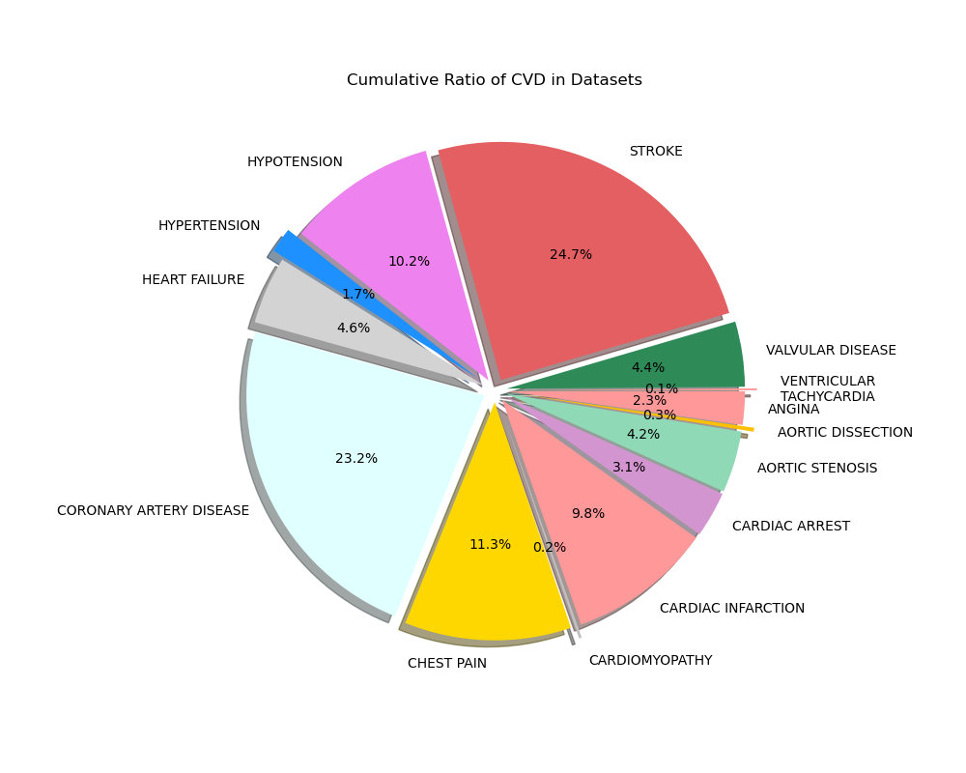
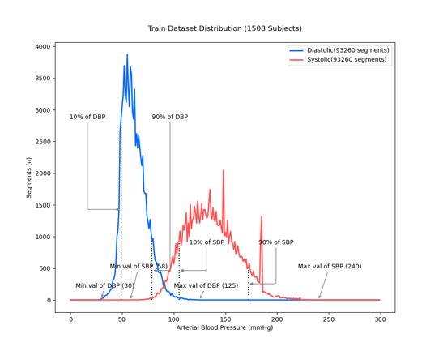
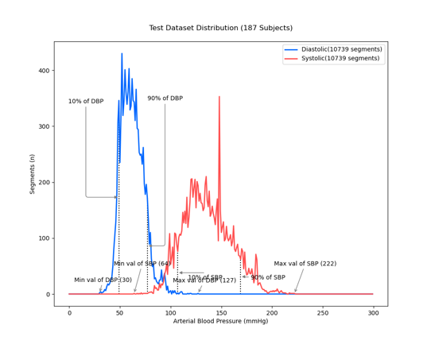
MIMIC Database(cont.)
Precautions during Pre-processing MIMIC Dataset
Tons of Problems with raw Signals!!! - Problems with Data Distribution (2)
Consideration of Disease Distribution
Seperation in Train / Test set

Slide 15
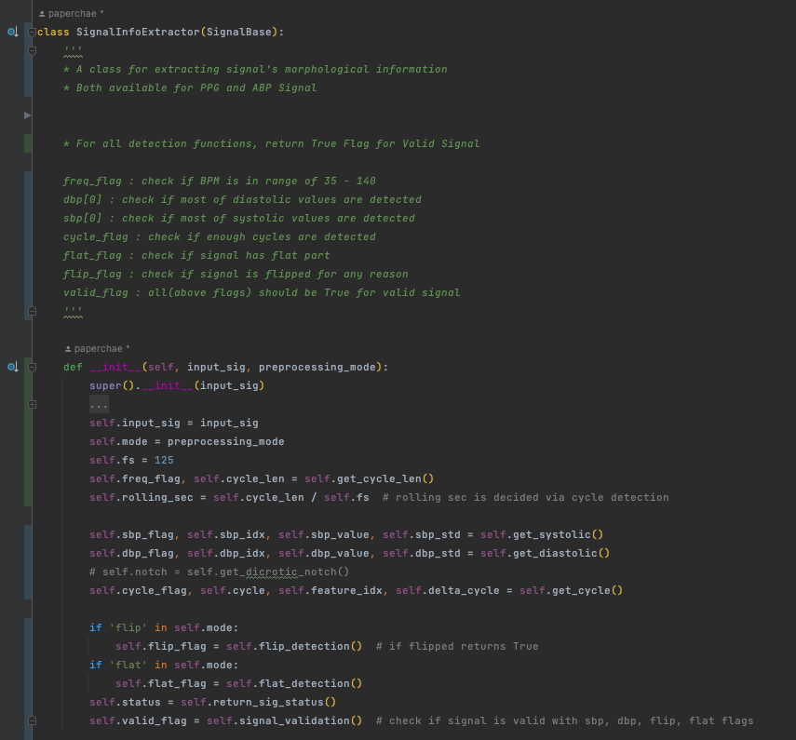
MIMIC Database(cont.)
Feature Extraction from 1D Signal

Slide 16
MIMIC Database(cont.)
Valid Signal Count
 | none | none | none | damp | damp | damp | flat | flat | flat | flip | flip | flip | total | total | total
 | Train | Validation | Test | Train | Validation | Test | Train | Validation | Test | Train | Validation | Test | Train | Validation | Test
light0 | 0 | 0 | 0 | 0 | 0 | 0 | 0 | 0 | 0 | 0 | 0 | 0 | 0 | 0 | 0
light1 | 410 | 36 | 27 | 410 | 36 | 27 | 396 | 35 | 26 | 399 | 36 | 27 | 385 | 35 | 26
light2 | 6875 | 803 | 904 | 6874 | 802 | 904 | 6723 | 767 | 888 | 6632 | 776 | 886 | 6479 | 739 | 870
light3 | 25449 | 3147 | 2856 | 25437 | 3146 | 2856 | 25180 | 3090 | 2834 | 24769 | 3033 | 2836 | 24449 | 2984 | 2814
heavy1 | 37382 | 4788 | 3771 | 37380 | 4788 | 3771 | 37221 | 4756 | 3759 | 36942 | 4715 | 3743 | 36778 | 4681 | 3731
heavy2 | 41207 | 5121 | 4110 | 41205 | 5121 | 4110 | 41133 | 5107 | 4108 | 40919 | 5089 | 4065 | 40843 | 5075 | 4063
total | 111323 | 13895 | 11668 | 111306 | 13893 | 11668 | 110653 | 13755 | 11615 | 109661 | 13649 | 11557 | 108934 | 13514 | 11504
count |  |  |  | 17 |  |  | 670 |  |  | 1662 |  |  | 2389
pecent |  |  |  | 0.0152708 |  |  | 0.6018522 |  |  | 1.4929529 |  |  | 2.1460075

Slide 17
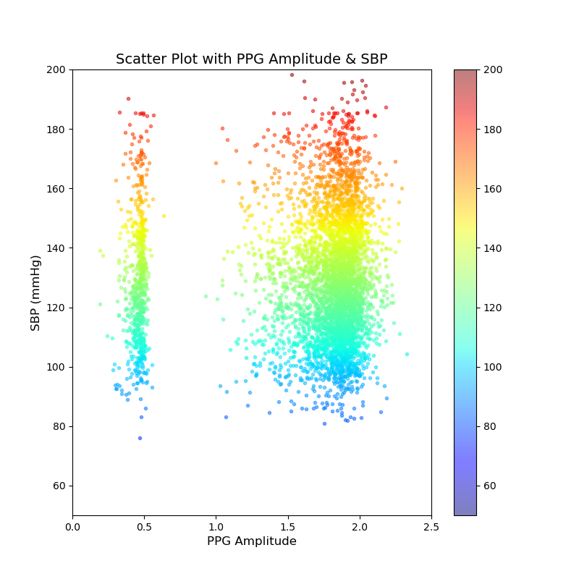
MIMIC Database(cont.)
Data Analysis – PPG Amplitude
Similar amplitude
그림 5. 그림 PPG, ABP를 시간(t)를 축으로 그린 3차원 plot
같은 ABP 크기를 가지지만 다른 크기의 ppg
그림 6. PPG의 Amplitude 와 SBP 의 Scatter Plot

Slide 18
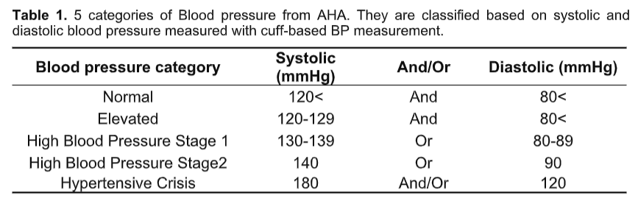
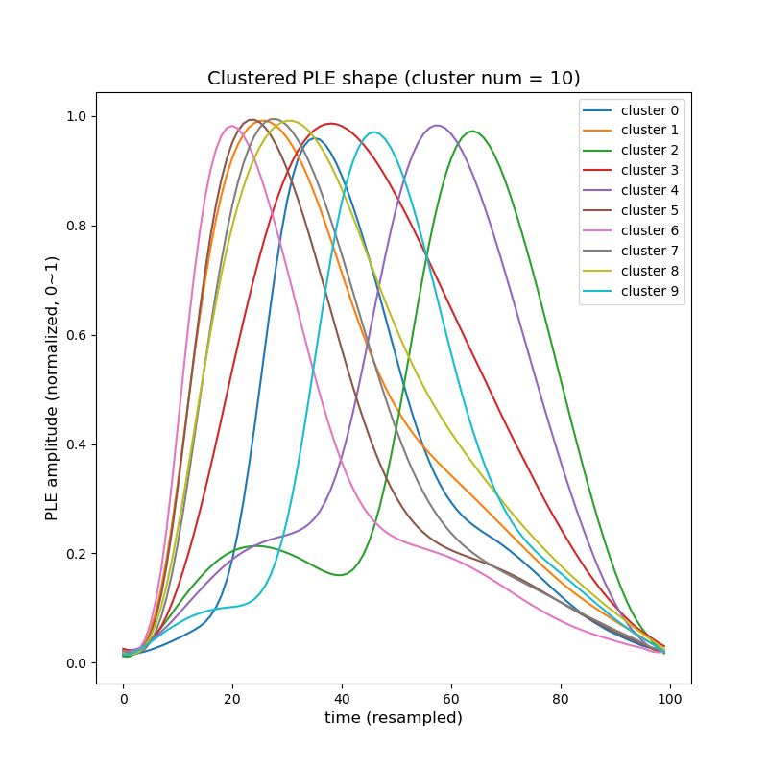
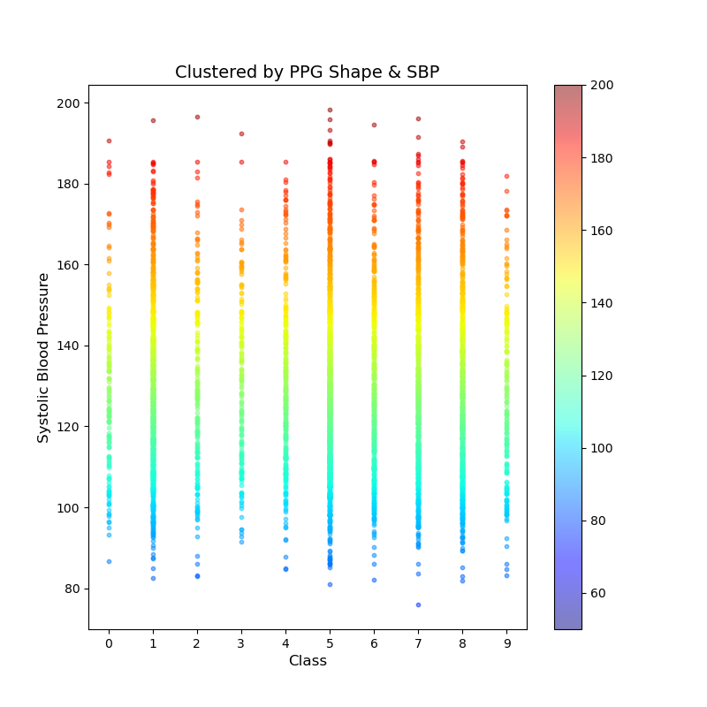
MIMIC Database(cont.)
Data Analysis – PPG Shape
Hypertensive Crisis
Stage 1
그림 9. PPG의 Shape 별 Clustering

Slide 19
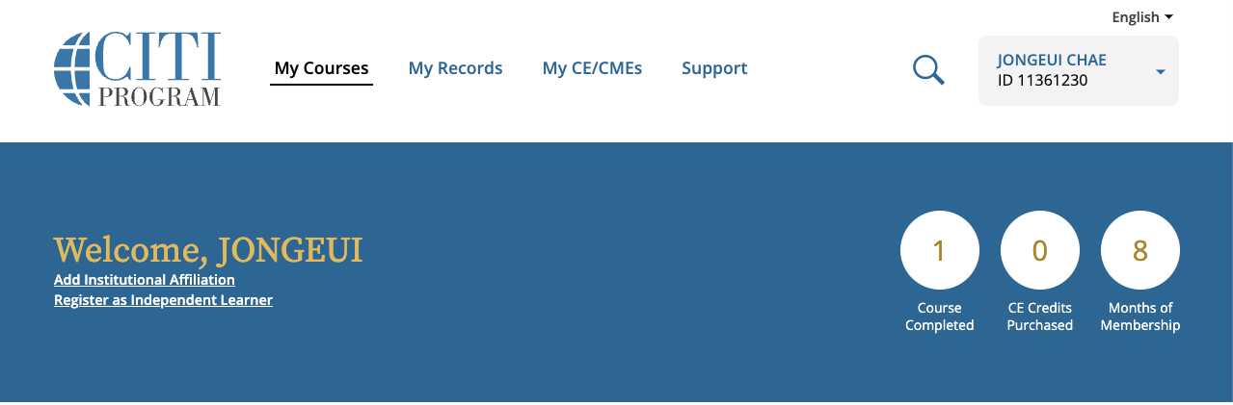
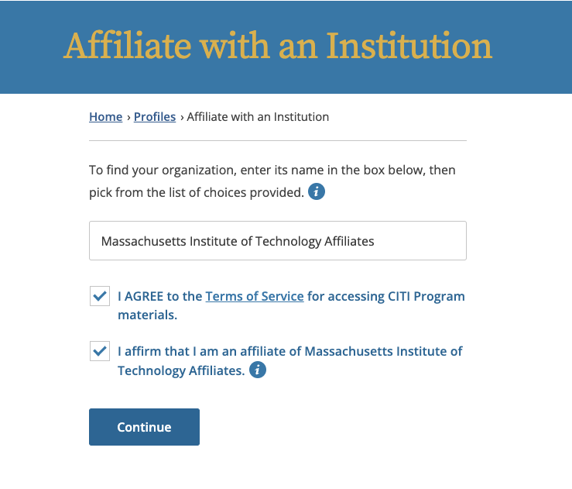
MIMIC Dataset - Acqusition
CITI Course Instructions
Visit CITI PROGRAM, create an account.
Click Add Institutional Affiliation, select affiliation as “Massachusetts Institute of Technology Affiliates”

Slide 20
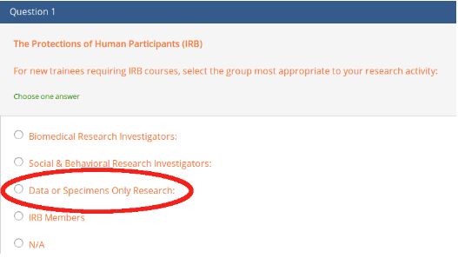
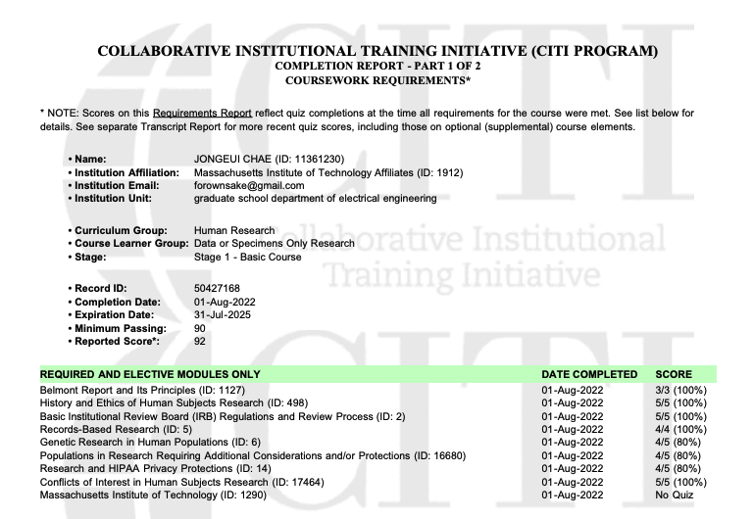
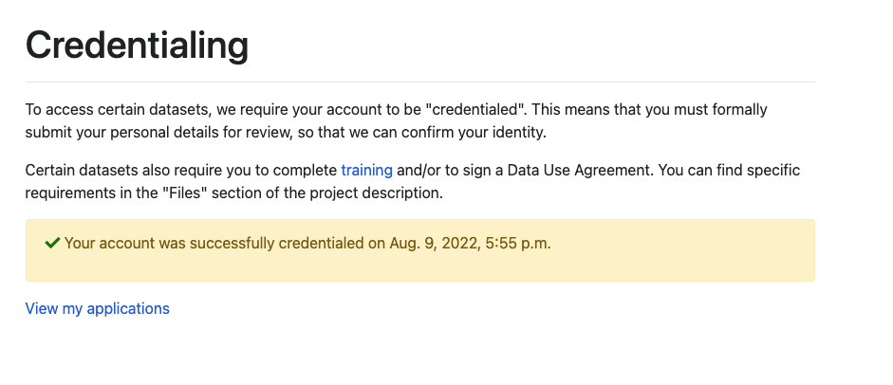
MIMIC Dataset - Acqusition(cont.)
CITI Course Instructions
Select the “Data or Specimens Only Research” course.
Complete the course. And apply for PhysioNet credentialing with Completion report PDF.

Slide 21
감사합니다
Q&A

